Slide 1



Slide 2

Web Application Development
Develop a Web Application using Servlet MVC Design Pattern
Name of Application : Bank Application
Design Specifications to be used for reference
  Database Design created in Project Phase 1
  Front End Design created in Project Phase 2

Slide 3
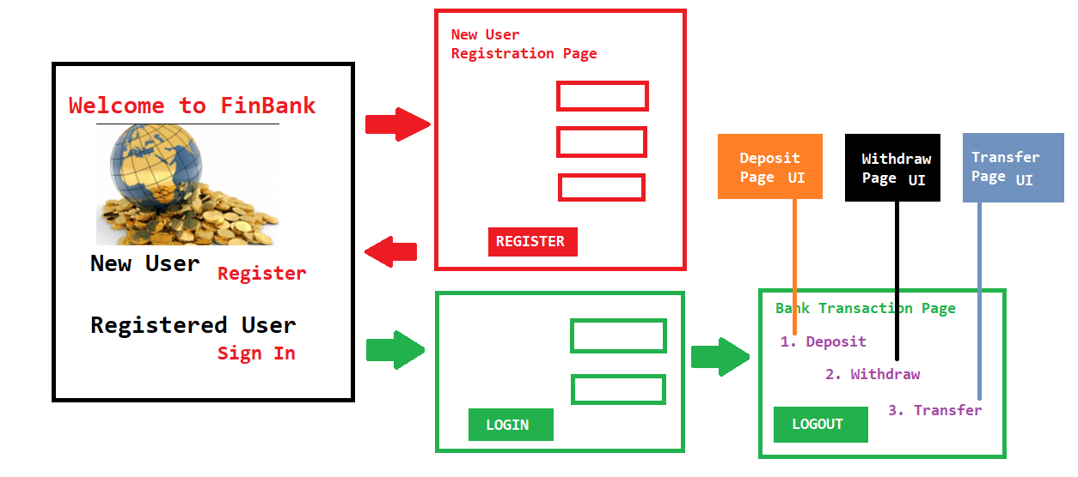
Web Application Development – Front End Spec

Slide 4


Web Application Development – Back End Coding
Develop an application for Bank which facilitates the following:
  Non-Login Home Page
    About Us - Contact Us ( May contain other essentials of Domain)
  Login Authorization.
  Registration of new account
  Deposit, Withdraw and Transfer facility
  Closure of the account
Provide following features for enhanced state of application
  In any case, the Account Balance can not be negative.
  Validate the required fields only for physical values. Any attempt to enter blank value should be denied.

